Slide 1
Sprint #1
IGVC

Slide 2
Sprint Goal
For this sprint we plan on finishing our project charter and setting up an outline for our entire project.

Slide 3
Sprint Backlog
Item | Time Estimate (hours)
Vision, Mission, Success Criteria | 8
Background | 5
Related Work | 2
System Overview | 2
Roles and Responsibilities | 3
Cost Proposal | 2

Slide 4
Sprint Backlog (Continued)
Item | Time Estimate (hours)
Facilities and Equipment | 2
Assumptions and Constraints | 4
Risks | 5
Documentation and Reporting | 25

Slide 5
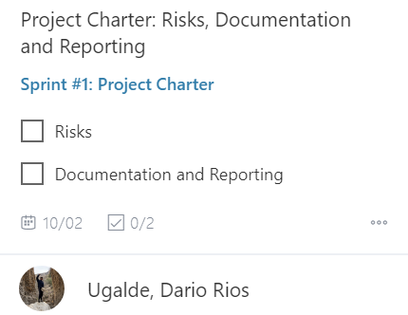
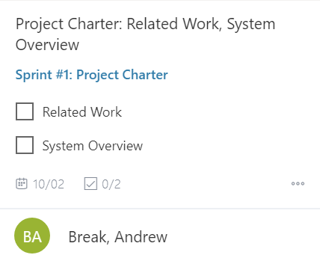

Slide 6
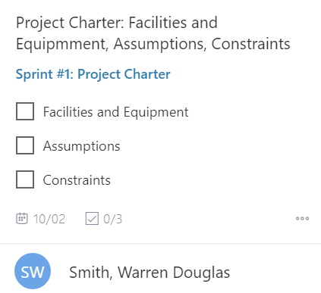
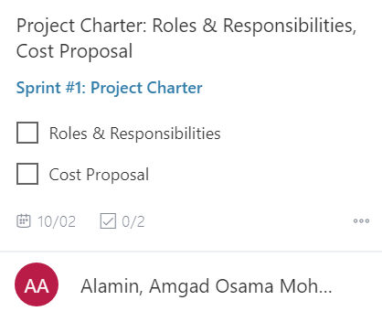

Slide 7
